Slide 1
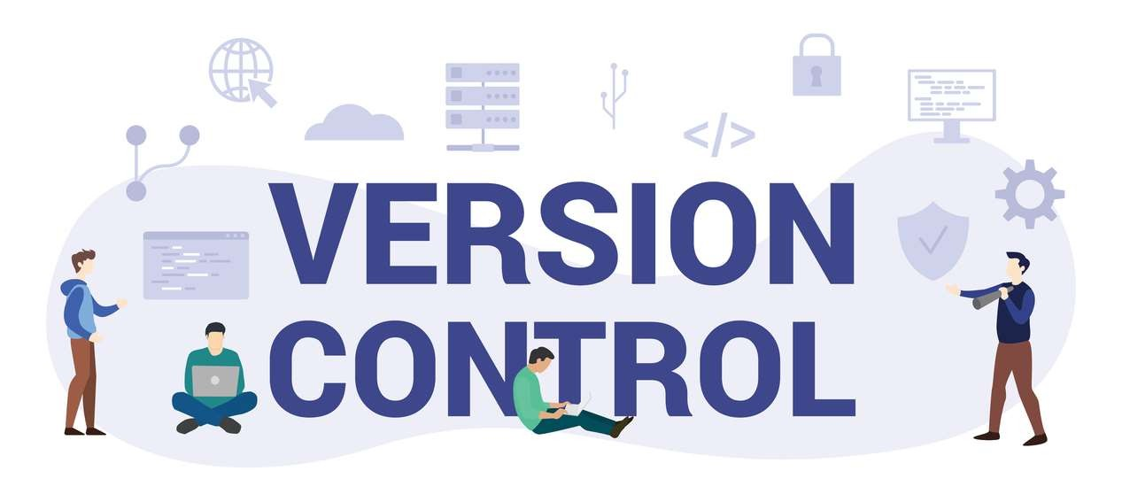
By Nada Mostafa

Slide 2
What is version control?
▶ Version control, also known as source control, is the practice of
tracking and managing changes to software code.
▶ Version control software keeps track of every modification to the code in a special kind of database. If a mistake is made, developers can turn back the clock and compare earlier versions of the code to help fix the mistake.

Slide 3
Version Control Terminologies
▶ Repository
▶ Branch
▶ Local Repo
▶ Remote Repo
▶ Commit (snapshot or save records(changes))
▶ Clone (from local or remote)
▶ Push (upload local changes to remote)
▶ Pull (you pull changes from remote repo to your local)
▶ Pull request (tell other about your changes to pull it from local to remote)

Slide 4
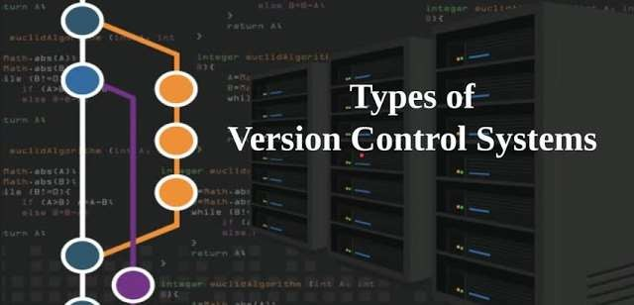
local version control
centralized version control
distributed version control

Slide 5
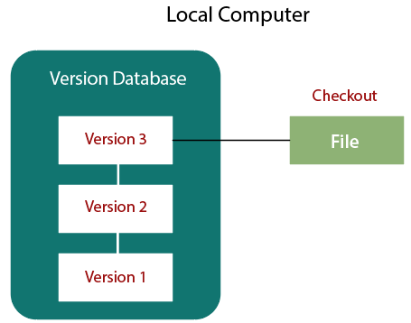
Local Version Control

Slide 6
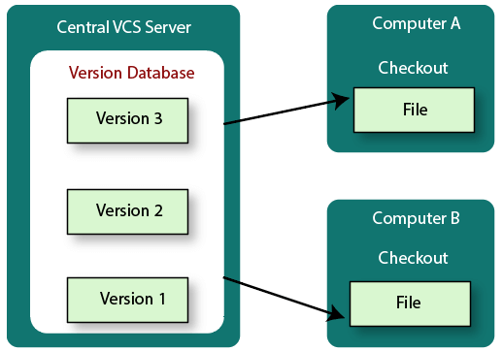
Centralized version control systems are based on the idea that there is a single “central” copy of your project on a server, and programmers will “commit” their changes to this central copy.

Slide 7
Disadvantages
▶ If the main server goes down, developers can’t save versioned changes.
▶ Need internet connection to commit the changes.

Slide 8
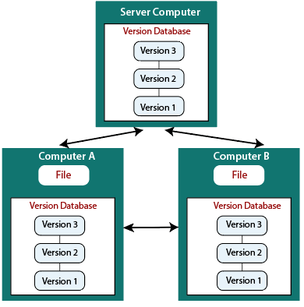
Distributed VCS
▶ These systems do not necessarily rely on a central server to store all the versions of a project’s files. Instead, every developer “clones” a copy of a repository and has the full history of the project on their own hard drive.
▶ The act of getting new changes from a repository is usually called “pulling”, and the act of moving your own changes to a repository is called “pushing.

Slide 9
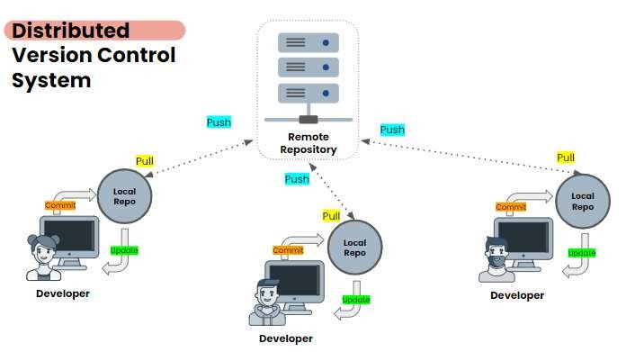

Slide 10
Advantages
▶ Committing new changes can be done locally without anyone else seeing them. Once you have a group of changes ready, you can push all of them at once.
▶ Everything but pushing and pulling can be done without an internet
connection. So you can work on a plane.
▶ Since each programmer has a full copy of the project repository, they can share changes with one or two other people at a time if they want to get some feedback before showing the changes to everyone.

Slide 11

Distributed VCS Examples
▶ Git

Slide 12
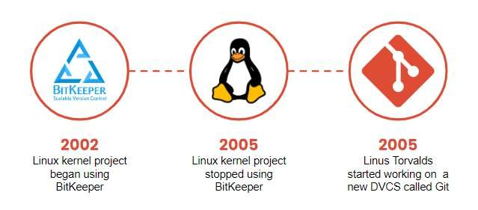
Git history

Slide 13
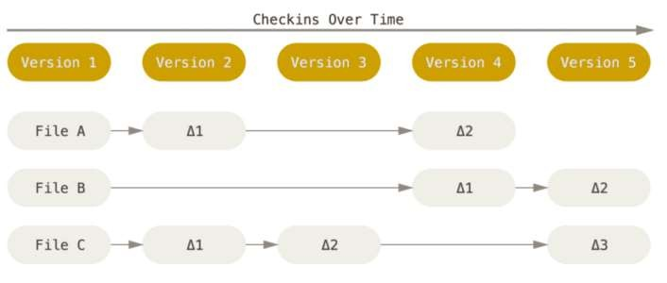
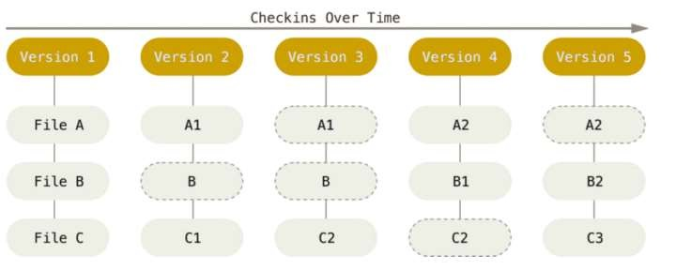
Advantages of git
others VC
Git

Slide 14
▶ The Git Version Control System uses SHA-1 checksums on the contents of all change commits. In fact, the checksum is used as commit identifier and commonly referred to as "the SHA".
▶ Git's checksums include metadata about the commit including the author,
date, and the previous commit's SHA.
▶ Git assures the integrity of the data being stored by using checksums as identifiers. If someone were to try to alter a commit or its meta data, it would change the SHA used to identify it. It would become a different commit.

Slide 15
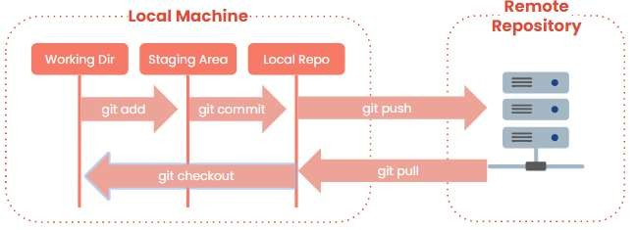

Slide 16
Git file states
▶ Un Tracked (U)
▶ Git has three main states that your files can reside in: Tracked
▶ Modified means that you have changed the file but have not committed it to
your database yet.
▶ Committed (unmodified) means that the data is safely stored in your local
database.
▶ Staged means that you have marked a modified file in its current version to
go into your next commit snapshot.

Slide 17
First Time Git Setup
▶ The first thing you should do when you install Git is to set your user name and
email address.
▶ This is important because every Git commit uses this information, and it’s
immutably baked into commits you start creating.
▶ git config --global user.name “your name”
▶ git config --global user.email “your e-mail”

Slide 18
Starting a repo
▶ mkdir firstdemo
Make a directory
▶ cd firstdemo
Change directory to the above directory
▶ git init
Initialize an empty Git repository
▶ ls –a
List all the files & dir and the hidden files & dir

Slide 19
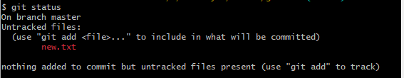
Create a new file
▶ touch new.txt
Create a new file called new.txt
▶ echo “hello git” << new.txt
write in new.txt file
▶ git status

Slide 20

Add to Staging Area
▶ git add new.txt /git add * /.
Staging the new.txt file
▶ git status

Slide 21

Commit changes
▶ git commit -m “the first commit”
Commit the changes with msg
▶ git status

Slide 22
Add & Commit
▶ git commit -a -m “ commit”
▶ Add the changes & commit the changes in one line
▶ But , notice that this command doesn’t add new files
▶ It only works with the changes that made inside the files itself

Slide 23

Git Logs
▶ git log
▶ git log --oneline

Slide 24
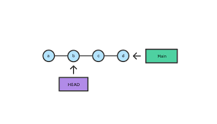

Slide 25
Git diff
▶ git diff
Show the unstaged differences since the last commit (working tree & stage
area)
▶ git diff --staged || --cached
Show the staged differences since the last commit (stage area & repo)
▶

Slide 26

Github
▶ is an Internet hosting service for software development and version control
using Git
▶ Github is source for project and sources [gitlab, bitbucket]
▶ Github simplify using git

Slide 27
Clone a Remote Repo
▶ Https or ssh
▶ Git clone https://github.com/****/*****
To clone the entire repository to your local machine in a new directory

Slide 28
Git SSH Keys
▶ SSH keys come in pairs, public key that gets shared with services like GitHub and a private key that is stored only on your computer. If the keys match, you’re granted access.
▶ Generate a new SSH key pairs
▶ ssh-keygen -t ed25519 -C "your e-mail“
▶ Copy the public key to your GitHub account
▶ cat ~/.ssh/id_ed25519.pub

Slide 29
Add / Remove Remote Repo from existing project
▶ git remote add origin https://github.com/Nadamostafa2/anyrepo.git
To add a remote repository
▶ git remote -v
To list the remote repositories
▶ git remote rm origin
to remove the remote repo

Slide 30
Why use version control?
▶ Developers contribute to the same project
▶ helps teams collaborate to fix issues & create new features
▶ You can control and backup your code (revert changes)
▶ Accelerates product delivery
▶ Keeping Track of All the Modifications Made to the Code
▶ Working on a new features without affecting the working code by branching

Slide 31
Lab
▶ Install Git.
▶ Create an account on GitHub.
▶ Create a new local repo and a remote repo on GitHub, then make a file
contains your full name , then push it to the remote repo .
▶ Create a new remote repo on GitHub and clone it.
▶ Send me 🡺 nadamostafa44127@gmail.com

